Slide 1
CDC – Fraud Detection Demo
Oracle Financial Services Consulting
December, 2020

Slide 3

Agenda
1
How are we working with our clients on their digital platform journey?
2
CDC Fraud Detection: Use Case
Problem Statement
Approach/Solution
CDC Features: User Story, Demo
3
Next Steps

Slide 4



How are we working with our clients on their digital platform journey?
‘Product Mindset’ Approach
Discover
Design
Development
Delivery
Understand the digital platform vision, business drivers Discover the current and future state Define the Digital Platform Implementation Roadmap Discover right technologies and solutions by building POTs/MVPs | Domain Driven Design Micro-service Architecture Evolve Microservices Canvas API Strategy Problem Space Definition Teams by Domain responsibility Day 0 Automation Strategy | Small, Agile, Autonomous teams Identify Technology Frameworks Abstract Cloud Services Create Development Platform Adopt 12 Factor Principles | 3 Standard Phases – CI, CD-D Industry Standard Tools Adaptation of Best Practices
Containerized Proven Architecture | Optimized Teams Rapid Delivery | Satisfied Customer

Slide 5
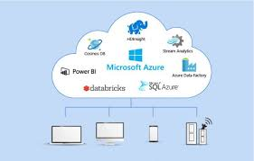
Credit Card Fraud Detection Using CDC
Problem Statement :
To Identify fraudulent credit card transactions using CDC (Change Data Capture) data source and TensorFlow model
Key aspects to be accounted for in “Design /Solution”:
CDC (Change Data Capture) Debezium
TensorFlow Model
Micrometer
Prometheus
Grafana
Postgres (Database)
MySQL
Influx DB
Kafka
Spring Cloud Data Flow Server on top of
Skipper Server
Notes:
Independent development and freedom to choose technology – Developers can work on different microservices at the same time and choose the best technologies for the problem they are solving.
Independent deployment and release cycle – Microservices can be updated individually on their own schedule.
Granular scaling – Individual microservices can scale independently, reducing the overall cost and increasing reliability.
Simplicity – Smaller services are easier to understand which expedites development, testing, debugging, and launching a product.
Fault isolation – Failure of a microservice does not have to translate into failure of other services.

Slide 6
Credit Card Fraud Detection Using CDC
Solution :
Built an application to address the existing fraudulent credit card transaction challenges.
TensorFlow model which has ML algorithm to analysis the time series data to capture data anomalies.
Easy integration with Spring Cloud Dataflow, Skipper and Kubernetes without any impact to the existing time proven legacy business systems.
Fraud-Detection: Product Features
#1: CDC (Change Data Capture) Debezium
#2:Spring Cloud Dataflow Data Pipeline for streaming application to analyze real time data. Build Real time interactive dashboard
#3: TensorFlow Model to implement Predictive analytics
#4: Prometheus and Grafana : Prometheus stores our metric data in time series in memory and Grafana provides a rich UI to monitor data
Notes:
Independent development and freedom to choose technology – Developers can work on different microservices at the same time and choose the best technologies for the problem they are solving.
Independent deployment and release cycle – Microservices can be updated individually on their own schedule.
Granular scaling – Individual microservices can scale independently, reducing the overall cost and increasing reliability.
Simplicity – Smaller services are easier to understand which expedites development, testing, debugging, and launching a product.
Fault isolation – Failure of a microservice does not have to translate into failure of other services.

Slide 7

Discovery
Objectives : Overall objectives to be achieved on CDC Fraud-Detection
Conducted the discovery phase to
Business Aspect
Pain Points of customers/current challenges
What services and experiences business wants to provide to customer
Application Aspect
Understand functional and technical landscape
Determine Functional Gaps & Technical challenges
Establish Functional Architecture for its implementation
Engineering Aspect
Design, Develop & Deliver
Abstract the complexities of platform from the developers
Best Practices
Technology Aspect
Compute
Data
Messaging
Notes:
Independent development and freedom to choose technology – Developers can work on different microservices at the same time and choose the best technologies for the problem they are solving.
Independent deployment and release cycle – Microservices can be updated individually on their own schedule.
Granular scaling – Individual microservices can scale independently, reducing the overall cost and increasing reliability.
Simplicity – Smaller services are easier to understand which expedites development, testing, debugging, and launching a product.
Fault isolation – Failure of a microservice does not have to translate into failure of other services.

Slide 8
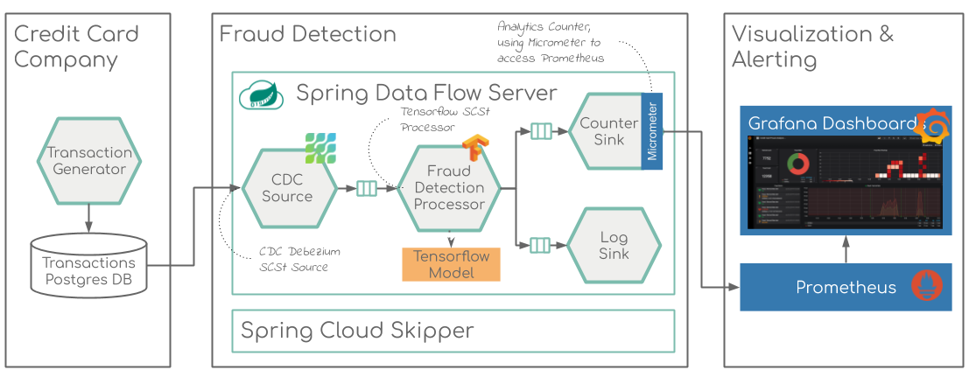
Credit Card Fraud Detection Using CDC
Reference Architecture
Notes:
Independent development and freedom to choose technology – Developers can work on different microservices at the same time and choose the best technologies for the problem they are solving.
Independent deployment and release cycle – Microservices can be updated individually on their own schedule.
Granular scaling – Individual microservices can scale independently, reducing the overall cost and increasing reliability.
Simplicity – Smaller services are easier to understand which expedites development, testing, debugging, and launching a product.
Fault isolation – Failure of a microservice does not have to translate into failure of other services.

Slide 9
Feature #1: CDC Debezium
In databases, change data capture (CDC) is a set of software design patterns used to determine and track the data that has changed so that action can be taken using the changed data
Methods for CDC
Date Modified
Differences values
Trigger
Log Based Data Capture
Credit card transaction persisted in Postgresdb which generates the change data capture event with help of Debezium connector as listed below.
MongoDB
MySQL
PostgreSQL
SQL Server
Oracle (Incubating)
Db2 (Incubating)
Cassandra (Incubating

Slide 10
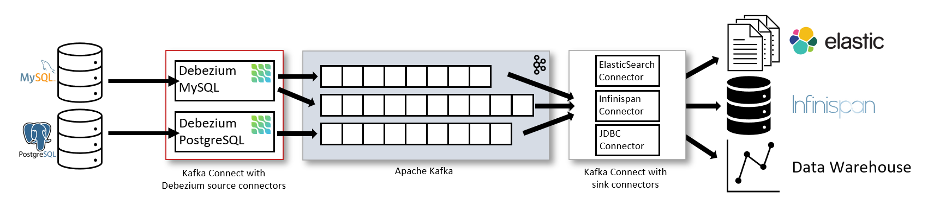
CDC Debezium
Debezium is an open source distributed platform for change data capture.
Start it up, point it at your databases, and your apps can start responding to all of the inserts, updates, and deletes that other apps commit to your databases.
Debezium is durable and fast, so your apps can respond quickly and never miss an event, even when things go wrong.

Slide 11
CDC Debezium
Transaction Generator
Standalone application that can continuously generate data records compliant with the data format specified in [Credit Card Fraud Detection]
Postgres DB
The data records are generated in random intervals and pushed into a pre-configured Database.
For confidentiality reasons the values of most of the original features, such as `V1`, `V2`, ... `V28` have been anonymized using a principal components obtained with PCA.
Transaction Handling with Event Source
Event sourcing persists the state of a business entity such an Order or a Customer as a sequence of state-changing events. In this use case on Credit Card Transaction whenever the state of a business entity changes, a new event is appended to the list of events.

Slide 12
Feature #2: Tensorflow Model
Custom Spring Cloud App Starter that extends the TensorFlow Processor to support a specific TensorFlow model build for the Credit Card Detection solution.
Tensor flow is the processor which has ML algorithm to analysis the time series data
to capture data anomalies.
Automatically enervates a schema based on underlying data as well as use the
schema to inspect out of time datasets
fraud_detection_graph.pb loaded as resource and it has been used as template to analysis the transaction received from transaction generation.
Identify anomalies, such as missing features, out-of-range values among others
Detect data drift by looking at a series of data

Slide 13
Feature #3: Spring Cloud Dataflow
Spring Cloud Data Flow provides tools to create complex topologies for streaming and batch data pipelines. The data pipelines consist of Spring Boot apps, built using the Spring Cloud Stream or Spring Cloud Task micro service frameworks.
Long lived applications requires Stream application while short lived application requires tasks application.
A flow that receives an event from an input, perform some action(s) and send the result to an output. From here, we can design more sophisticated and complex pipelines. The good thing with Spring Cloud Data Flow is that it’s fully integrated with Spring Integration, so we can implement any message patterns we can achieve with Spring Integration.
The inputs are the Source, the outputs are the Sink and then we have the Processor that consumes the data and returns it to the output. It can be any of these: a RabbitMQ queue, a Kafka, Amazon Kinesis, Google Pub/Sub, Azure Event, a database … or another component within your pipeline.

Slide 14
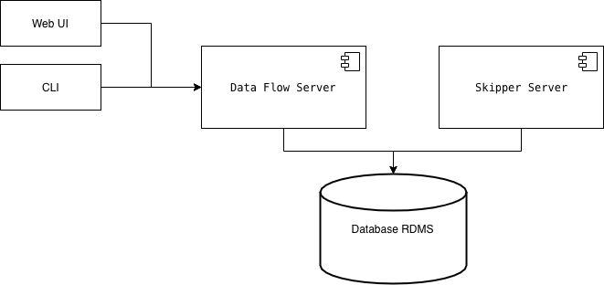
Spring Cloud Dataflow
Spring Dataflow Components
Data Flow Server:
- backend for Web and CLI, validate pipelines, registering .jar and docker images, deploying
batch jobs, …
Skipper Server: Stream jobs management (deploying, upgrading, history, …)
Both servers use a RDMS database. If not provided, it will use a volatile H2 instance.

Slide 15
Feature #4: Prometheus and Grafana
Prometheus stores our metric data in time series in memory by periodically pulling it via HTTP. The data can be visualized by a console template language, a built-in expression browser, or by integrating Grafana (which we will do after setting up Prometheus).
The included Prometheus browser graph is nice for basic visualization of our metrics but we will use Grafana instead. Grafana provides a rich UI where you create, explore and share dashboards that contain multiple graphs.
Grafana can pull data from various data sources like Prometheus, Elasticsearch, InfluxDB, etc.
InfluxDB is a time series platform — dashboards, queries, tasks and agents all in one place.
InfluxDB empowers developers to build IoT, analytics and monitoring software. It is purpose-built to handle the massive volumes and countless sources of time-stamped data produced by sensors, applications and infrastructure.
Ingest metrics, events and logs in a high-performing time series database capable of ingesting millions of data points per second.
Perform analytics to get faster detection, and resolution, or set up alerts or anomaly detection with a simple click.

Slide 16
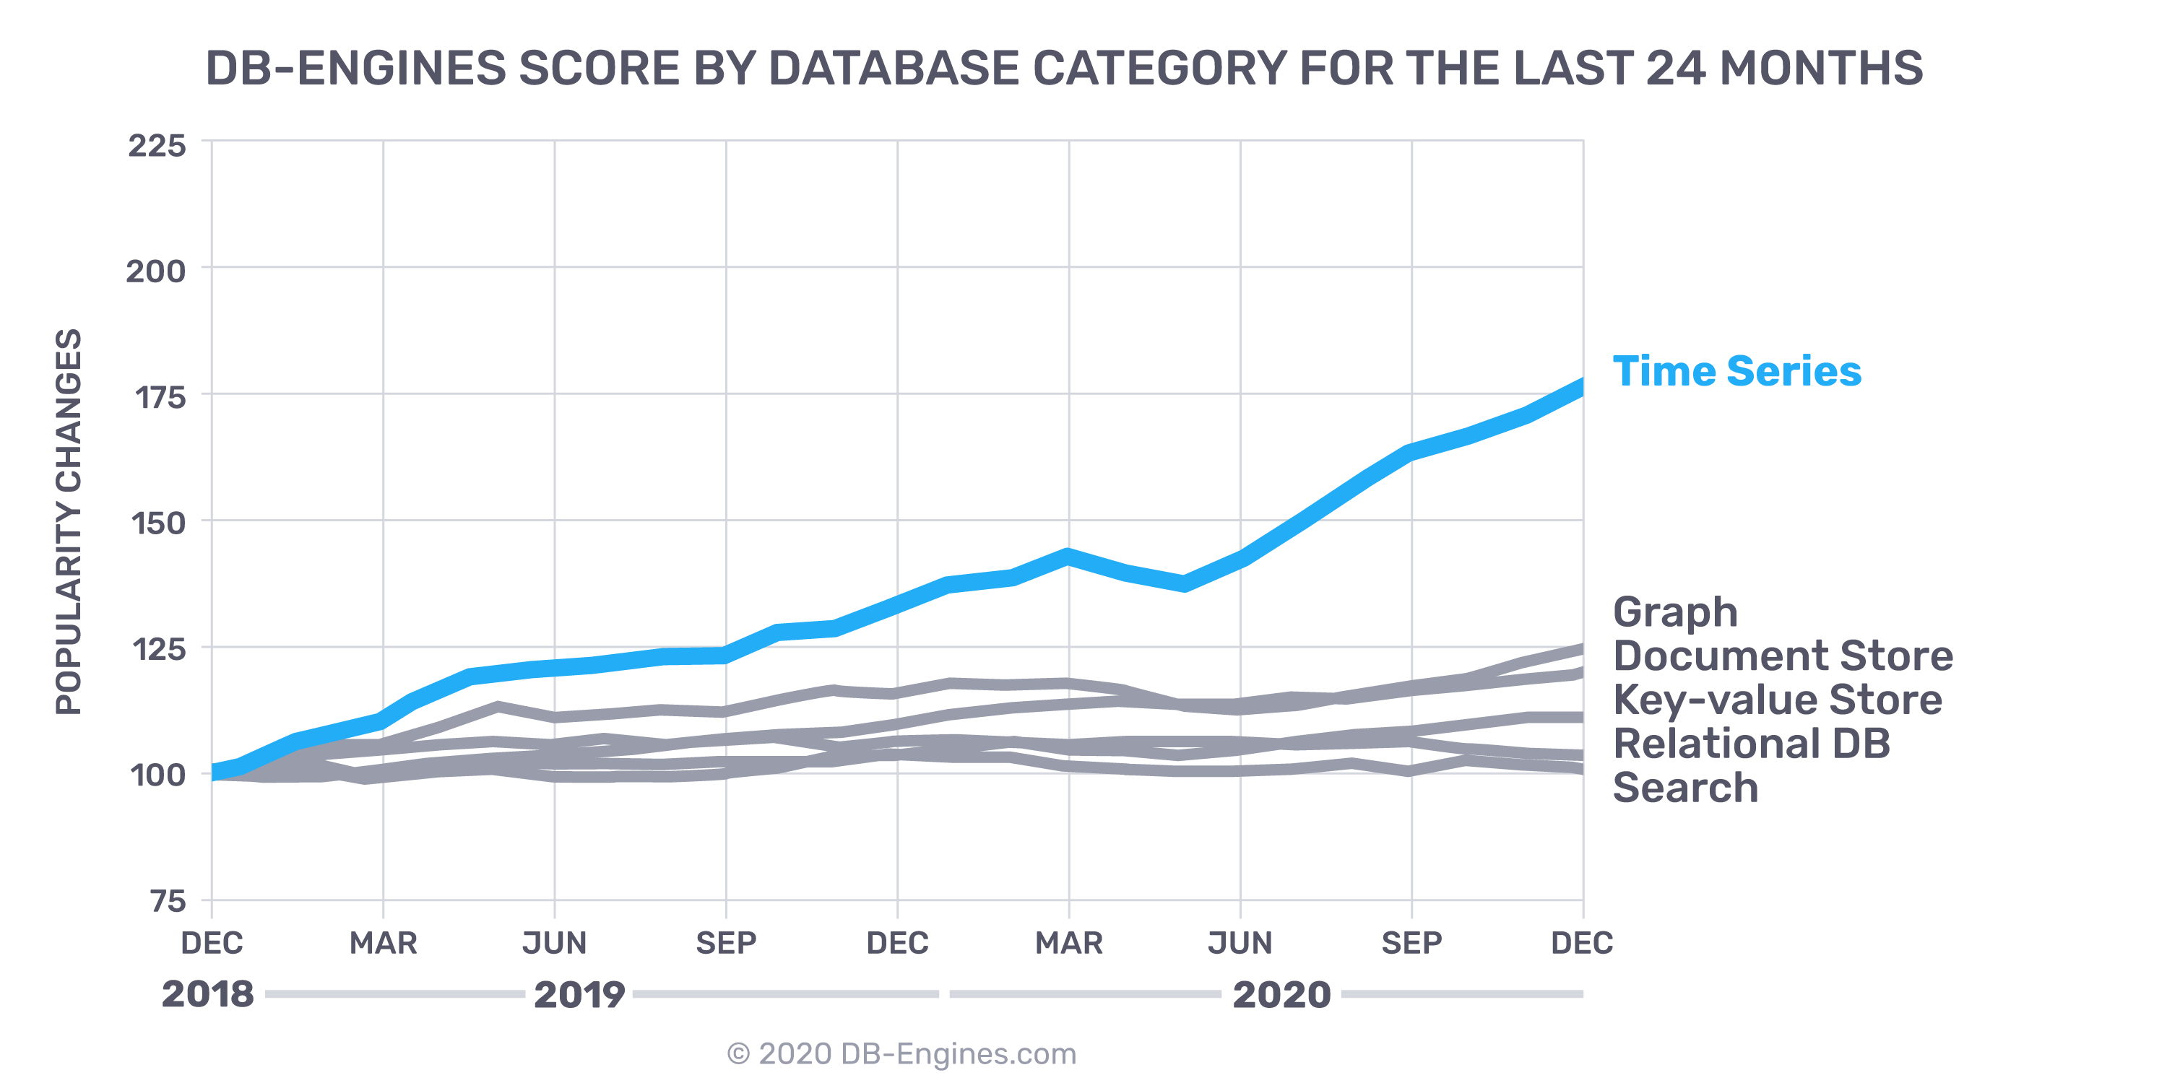
Prometheus and Grafana
Time Series - the fastest growing database category
Vision
From faces to feelings, allow your aps to understand images and video
Decision
Makes smarter decision faster
Search
Access billions of web pages, images, videos, and news with the power of Bing APIs

Slide 17

Credit Card Fraud Detection
Demo Time
Notes:
Independent development and freedom to choose technology – Developers can work on different microservices at the same time and choose the best technologies for the problem they are solving.
Independent deployment and release cycle – Microservices can be updated individually on their own schedule.
Granular scaling – Individual microservices can scale independently, reducing the overall cost and increasing reliability.
Simplicity – Smaller services are easier to understand which expedites development, testing, debugging, and launching a product.
Fault isolation – Failure of a microservice does not have to translate into failure of other services.

Slide 18
Thank You
Copyright © 2020, Oracle and/or its affiliates | Confidential: Restricted

